Slide 1


DEPARTMENT OF COMPUTER SCIENCE AND ENGINEERING
20CS7503 & DESIGN PROJECT – III
END SEMESTER PRACTICAL EXAMINATION- NOV / DEC 2025
REVIEW PRESENTATION
Batch No.: 13
Date: 28/11/2025
Session: AN

Slide 2
PERSONALIZED TRAVEL GUIDE BOOKING AND
ASSISTANCE PLATFORM
Guide Name:
Mr. M.A.Prasanna, B.E., M.Tech.
Assistant Professor, CSE.
Team Members:
Karolina A (811722104069),
Mubina Begum M(811722104094),
Ranjani S (811722104121).

Slide 3
OBJECTIVE OF THE PROJECT
The system offers an easy platform for tourists to find and book qualified local tour guides with verified profiles and real-time availability.
Secure payment methods ensure safe transactions, building trust between tourists and guides during the booking process.
A clear review and feedback system helps travelers choose reliable guides based on others’ experiences, thereby improving overall satisfaction.
The platform increases exposure for local tour guides, creating more opportunities and making the booking process simple and dependable for all.
.

Slide 4
INTRODUCTION
The platform connects tourists with verified local tour guides to provide a personalized travel experience.
Users can choose guides based on preferences like language, gender, expertise, and availability.
It replaces manual booking with a fast, easy-to-use digital system for both tourists and guides.
Guides can manage their schedules and bookings in real-time through the platform.
Travel agencies can monitor operations and optimize guide allocation to improve service quality.

Slide 5
LITERATURE SURVEY
TITLE OF PAPER | AUTHOR(S) | PAPER GIST | TECHNOLOGY USED
Big Data for Personalized Tour Guide Recommendations | Chen, L., Zhang, Y., Wang, X | Journal of Tourism Management 2021 | Big Data, Machine Learning, Recommender Systems.
Mobile-Based Tourist Guide Booking System | Singh, S., Patel, A | Journal of Mobile Technology in Travel and Tourism 2018 | Mobile apps (Android/iOS), GPS, Cloud computing.
User Experience in Online Guide Booking Platforms | Patel, M., Kaur, R. | International Journal of User Experience and Design 2020 | UX Design, Front- end Development.
Impact of User Reviews in Guide Booking | Zhang, P., Lee, H. | Journal of Social Media in Tourism 2022 | Social Media APIs, Sentiment Analysis

Slide 6
Big Data for Personalized Tour Guide Recommendations | Chen, L., Zhang, Y., Wang, X | Journal of Tourism Management 2021 | Big Data, Machine Learning, Recommender Systems.
Mobile-Based Tourist Guide Booking System | Singh, S., Patel, A | Journal of Mobile Technology in Travel and Tourism 2018 | Mobile apps (Android/iOS), GPS, Cloud computing.
User Experience in Online Guide Booking Platforms | Patel, M., Kaur, R. | International Journal of User Experience and Design 2020 | UX Design, Front- end Development.
Impact of User Reviews in Guide Booking | Zhang, P., Lee, H. | Journal of Social Media in Tourism 2022 | Social Media APIs, Sentiment Analysis

Slide 7
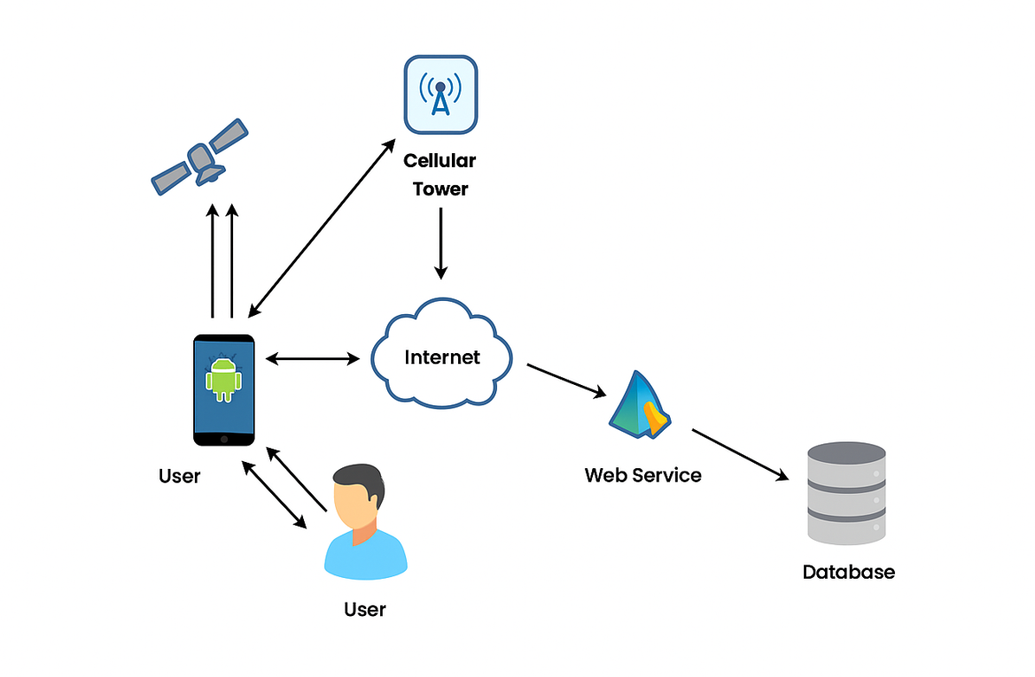
EXISTING SYSTEM ARCHITECTURE

Slide 8
PROBLEM IDENTIFICAITON
1.Lack of Verified Guides: Many existing platforms do not verify guide credentials, leading to trust and safety concerns.
2.Manual and Time-Consuming Booking: Tourists often rely on word-of-mouth or travel agencies for guide booking, which is inefficient and non-transparent.
3.Language and Preference Barriers: Tourists struggle to find guides who match their language, cultural, or gender preferences.
4.Limited Real-Time Availability: Current systems fail to synchronize bookings, resulting in double-booking or unavailability conflicts.

Slide 9
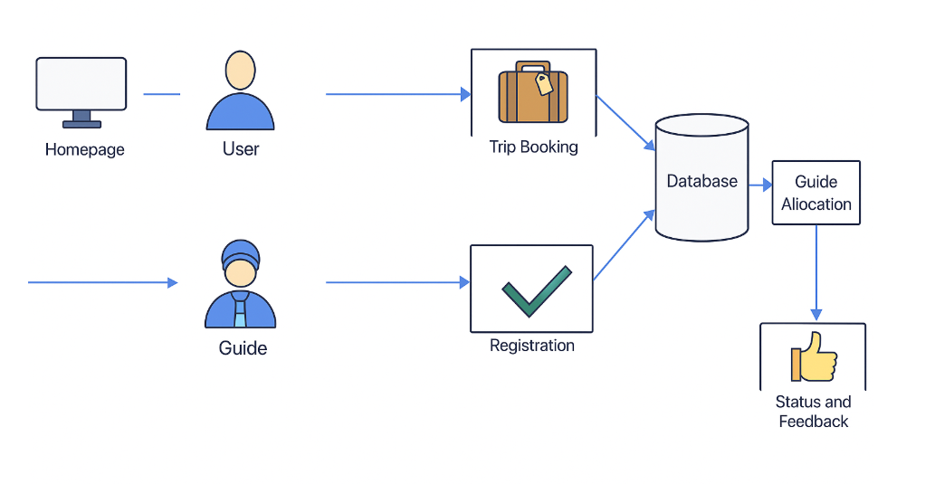
PROPOSED SYSTEM ARCHITECTURE

Slide 10
SOFTWARE AND HARDWARE REQUIREMENTS
HARDWARE
Processor : Dual-core processor,
2.6 GHz
RAM : 4GB
Hard disk : 320 GB
Compact Disc : 650 MB
Keyboard : Standard keyboard
SOFTWARE
Operating system : Windows OS
Front End : PHP
Backend : MySQL Server
Tool : Macromedia Dreamweaver 8

Slide 11
MODULES
User Registration & Authentication Module
Guide Profile Management Module
Tour Management Module
Booking & Reservation System Module
Review and Rating Module

Slide 12
IMPLEMENTATION OF MODULE-1
User Registration & Authentication Module:
The User Registration and Authentication Module handles secure sign-ups, logins, and profile creation for both tourists and guides. It includes password management and two-factor authentication to enhance security.
Role-based access control ensures that tourists and guides have appropriate permissions for their respective functions. Users can update personal details and preferences, providing a secure and personalized experience on the platform

Slide 13


Slide 14
IMPLEMENTATION OF MODULE-2
Guide Profile Management Module:
Guides create detailed profiles including personal information, qualifications, experience, languages spoken, availability, pricing, and media uploads such as photos and videos, while managing their schedules.
Tourists can browse guides by expertise, availability, and ratings, with the module facilitating efficient matching and bookings by providing accurate and up-to-date information.

Slide 15
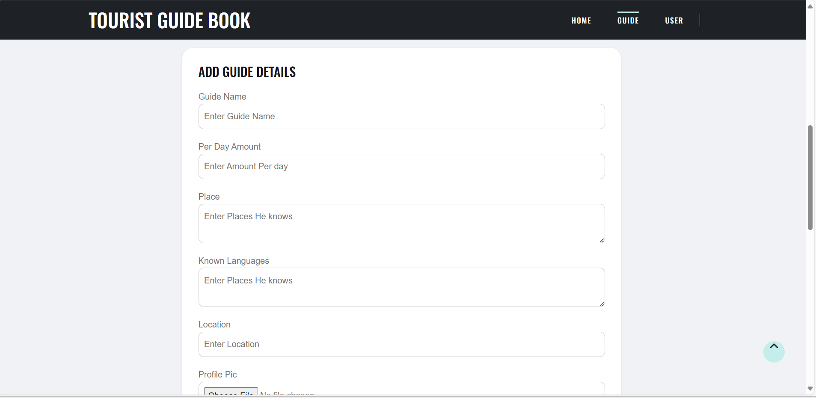
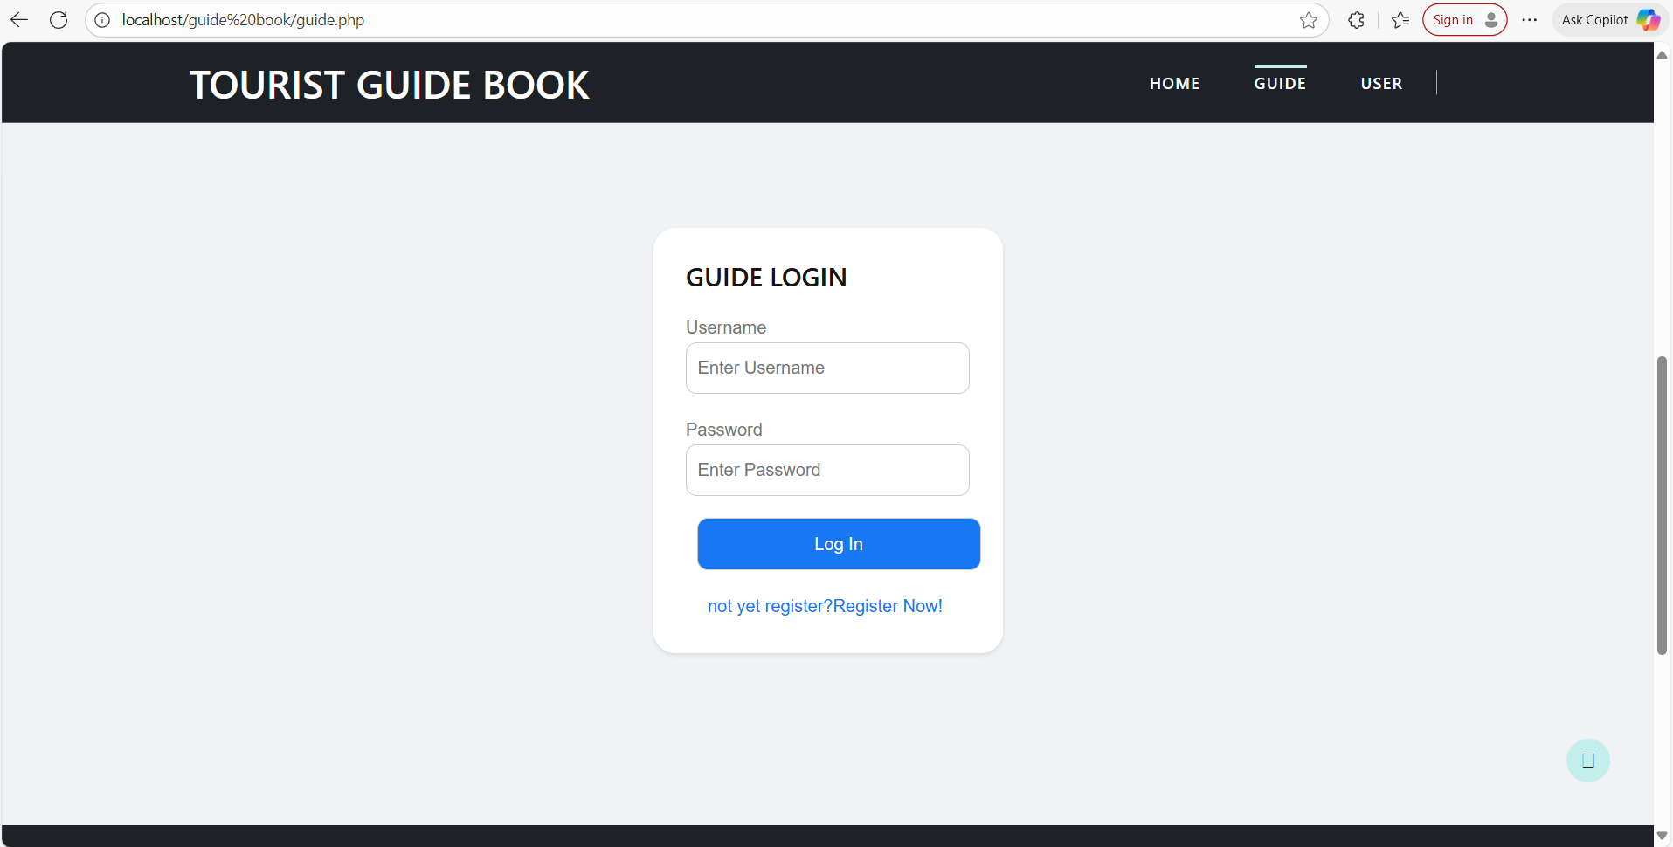
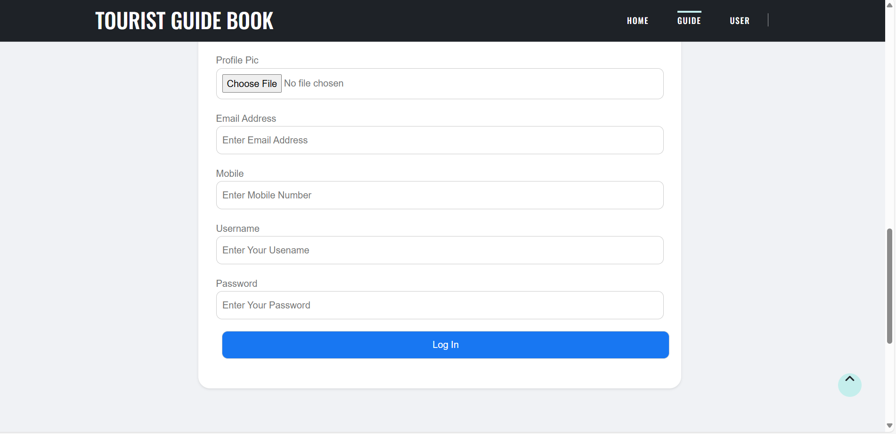

Slide 16
IMPLEMENTATION OF MODULE-3
Tour Management Module:
Guides can list and manage tours with detailed itineraries, pricing, durations, and descriptions, while tourists can search and filter tours by location, price, rating, and category.
Real-time availability prevents double bookings, simplifying the booking process by displaying only available tours and helping tourists find options that suit their preferences and travel plans.

Slide 17
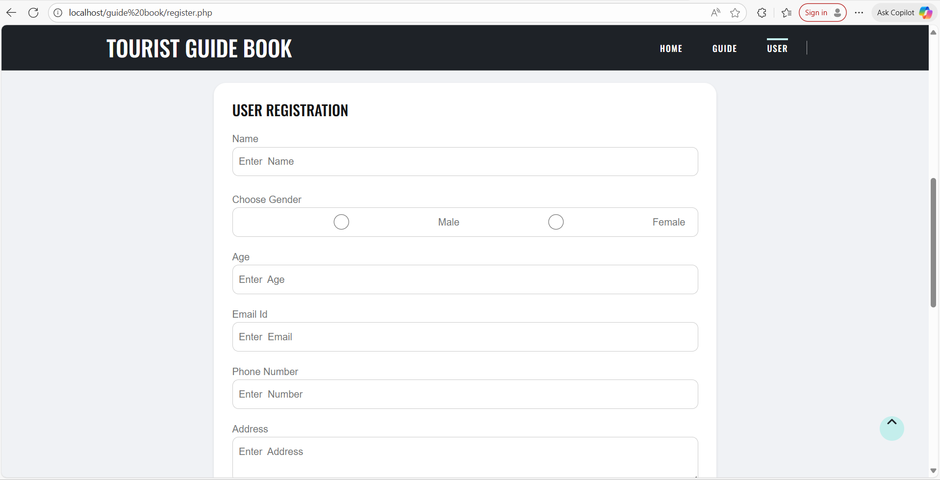
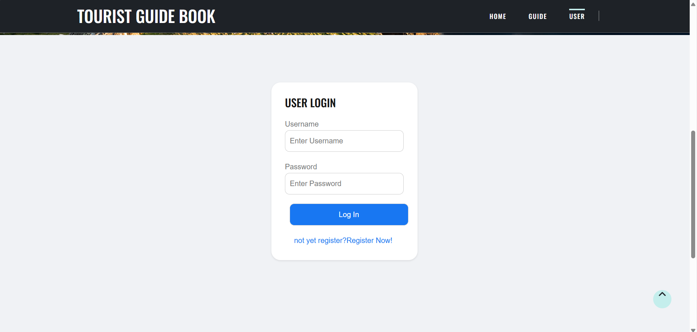
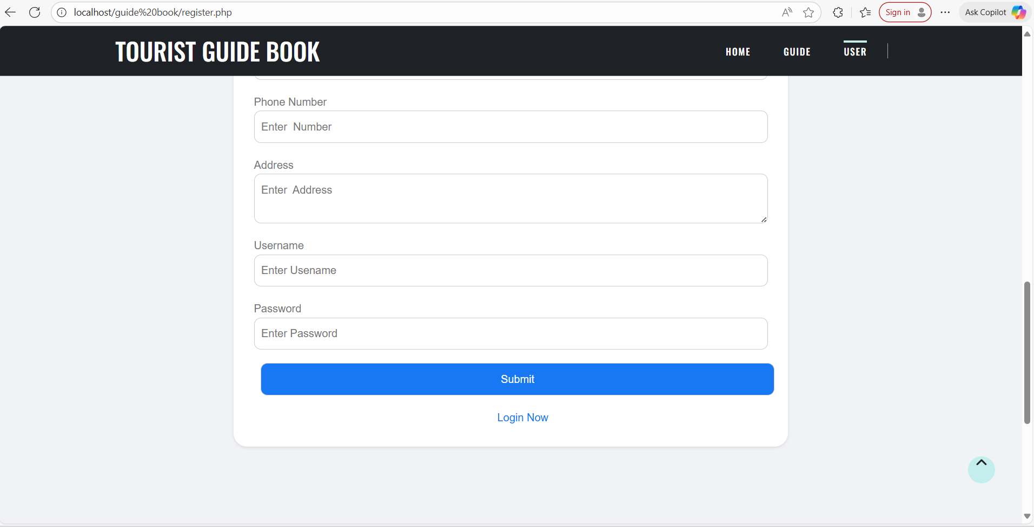

Slide 18
IMPLEMENTATION OF MODULE-4
Booking and Reservation System Module:
Tourists book tours by choosing guides, dates, and payment methods, with the system syncing to guides' calendars for real-time availability to avoid overbooking.
The module provides confirmations and reminders to tourists, allows guides to manage bookings, and handles cancellations, modifications, and booking history for a smooth experience.

Slide 19
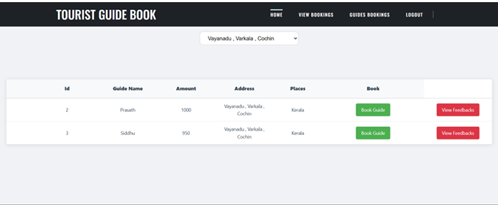

Slide 20
IMPLEMENTATION OF MODULE-5
Review & Rating Module:
Tourists can rate guides and tours, providing feedback on quality, knowledge, and overall experience, which helps future users make informed decisions.
Ratings are aggregated and displayed, guides can respond to feedback, and the system moderates reviews to maintain appropriate content, trust, and quality control.

Slide 21
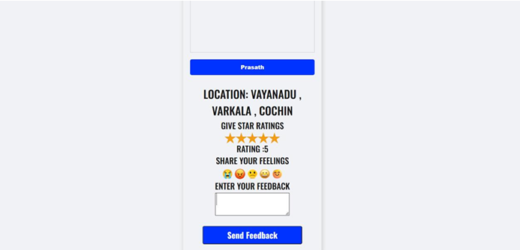

Slide 22
CONCLUSION
The platform simplifies the process of finding and booking trusted local tour guides.
Secure payments and verified profiles ensure safety and reliability.
Reviews and feedback foster transparency, helping travelers make informed choices.
By connecting tourists with guides, the system boosts opportunities for locals while enhancing travel experiences.

Slide 23
FUTURE ENHANCEMENTS
AI-Based Guide Recommendation: Integrate machine learning to suggest guides based on traveler preferences, history, and feedback.
Multilingual Chatbot Assistance: Provide instant help and automated query resolution in multiple languages.
Augmented Reality (AR) Tour Preview: Allow tourists to preview tours virtually using AR-based immersive visuals.
Emergency and Location Tracking System: Integrate GPS-based tracking and emergency alerts for traveler safety.

